Slide 1

ParkingPriceTag
How much is it for parking in San Francisco?
Sisun Cheng
Lan Xiao
Dec. 2021

Slide 2

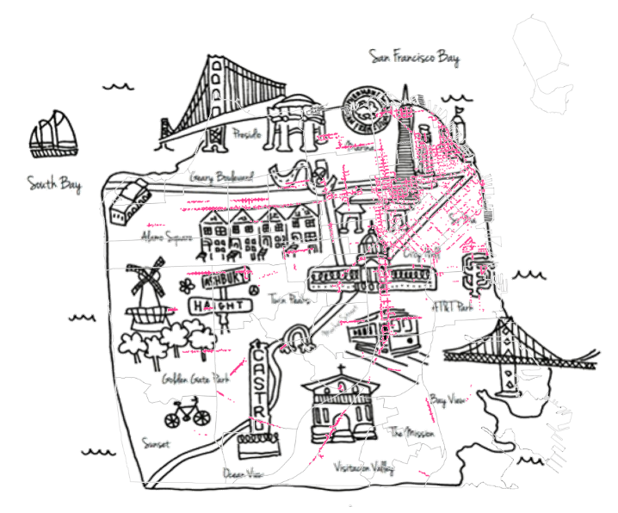
Status Quo
Clustering
Most of the parking behaviors cluster in the northeastern section of San Francisco, including Financial District, China Town, Fisherman’s Wharf, etc, where many commercial hot spots also gather here.
1
Floating pricing for on-street parking
Many on-street meters only operate during Monday to Saturday, 9am – 6pm. The prices differ by the day of the week, time of day, & neighborhood.
2
Exacerbating traffic congestion
Cruising while looking for a parking space has exacerbated traffic congestion in the lively streets of downtown San Francisco.
3

Slide 3
Use Case
Stakeholders
Our main stakeholder is SFMTA which operates most of the on-street parking in San Francisco.
We want to carry out a prediction model to help SFMTA with parking pricing process.
Problem of Underpricing
Overcrowded Roads
Underpricing of on-street parking
Negative Externalities
Congestion
Air pollution
Fuel consumption
Notes:
For decades, planning scholars have argued that curb parking tends to be underpriced and therefore overcrowded.
When curbside parking spaces are overcrowded, and vacant spaces are unavailable, drivers “cruise” in search of parking. Cruising creates negative externalities including congestion, air pollution and unnecessary fuel consumption. Furthermore, congestion prompted the creation of minimum parking requirements for most types of zoning districts.
*
3

Slide 4
Use Case
Demand-based Dynamic Pricing Model
How the model works
Parking fee rate changes with time and space, according to the parking demand.
Goals of the model
Optimize occupancy under 80% of on-street parking lots;
Increase overall car park revenues;
Reduce traffic congestion, air pollution, etc.
Real-time data vs. Predictions
Predict the upcoming car parking peak and adjust the parking fee rate in advance.

Slide 5
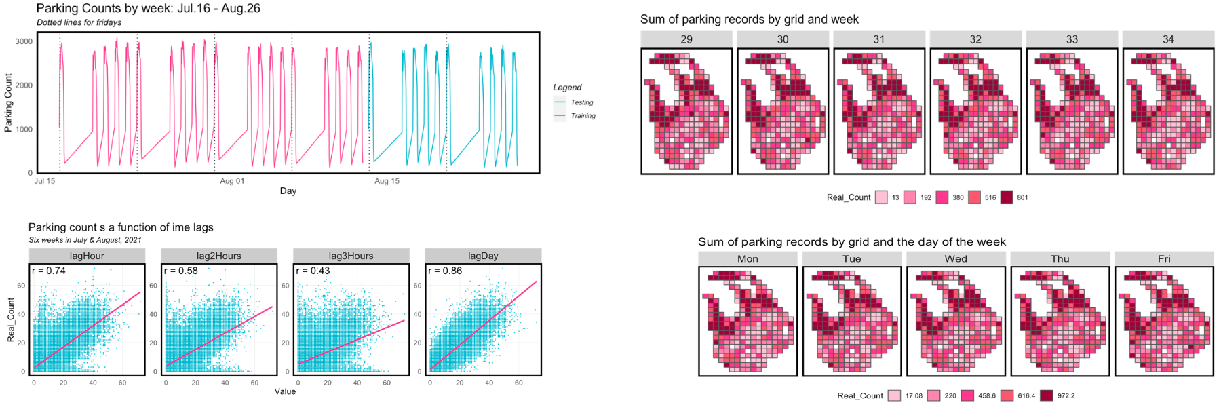
Exploratory
Analysis
Serial autocorrelation
The correlation decreases with additional lag hours, but predictive power returns with the 1 day lag. So these serial lag features would be effective predictors in a model.
Spatial autocorrelation
The spatial distribution pattern appears consistent, with parking concentrated in the Nob Hill, China Town, and North Beach.
1
2

Slide 6
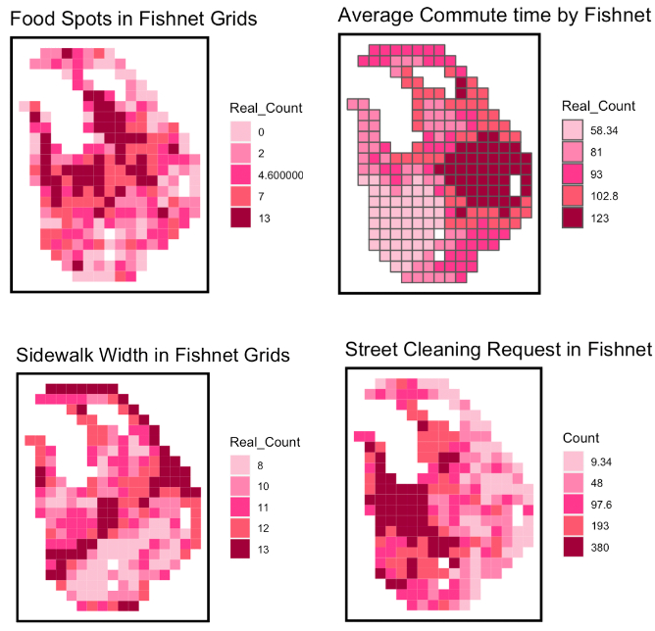
Exploratory
Analysis
Space/time correlation
Here, on-street parking data for a Monday (8:00 – 19:00) ,and 1-hours intervals are used.
Opportunity Factors
Exploratory the relationship between parking demand and various factors of built environment, neighborhood and road characteristics.
3
4

Slide 7
Modeling
Spatial Unit:
200m * 200m Grid
Temporal Unit:
1 Hour
77%
2 Temporal Features + 4 Time Lags + 14 Opportunity Factors

Slide 8
Modeling
Logic
Why not by meter?
Many homogeneous meters competes, leading to large contingency.
demand-based
spatial-temporal model
Why not by street?
Some streets are as long as miles, bias will be huge in this way.
Why fishnet grid?
It can better reveal the essence of on-street parking demand - the spatial proximity.

Slide 9
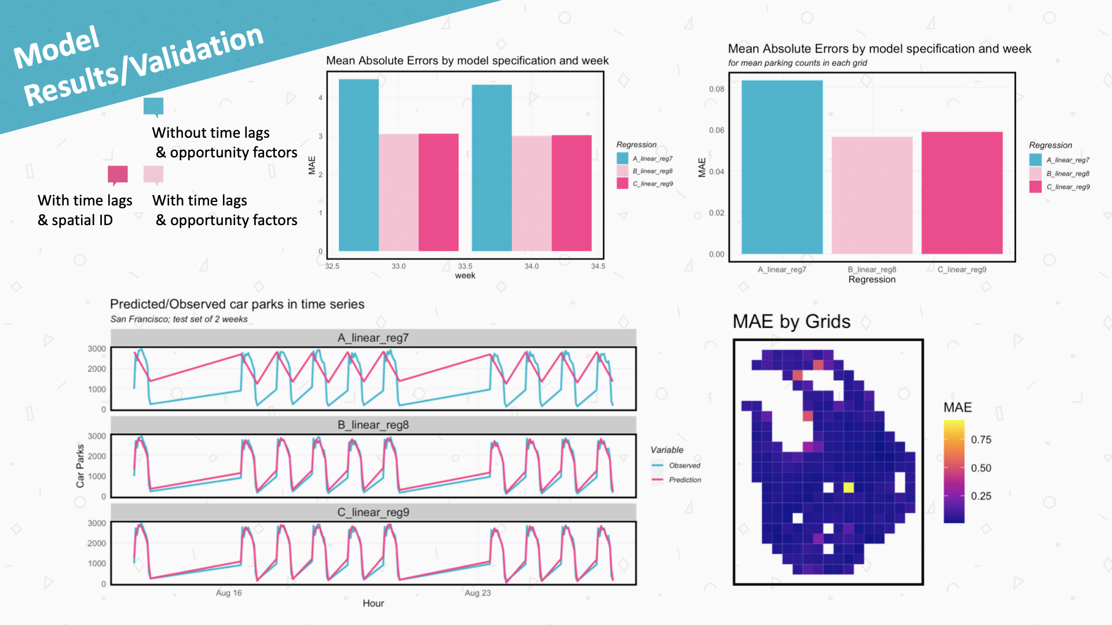

Slide 10
How to apply to PP-Tag
1 st
3 rd
Transforming
Input: parking amount for each grid now
Output: parking amount for each grid 1h later
occupancy Price
< 30% 3$
30% - 50% 3.5$
50% - 65% 4$
65% - 80%. 4.5$
> 80% 5$
Total parking
Meter amount
Occupancy
Computing
Pricing
2 nd

Slide 11
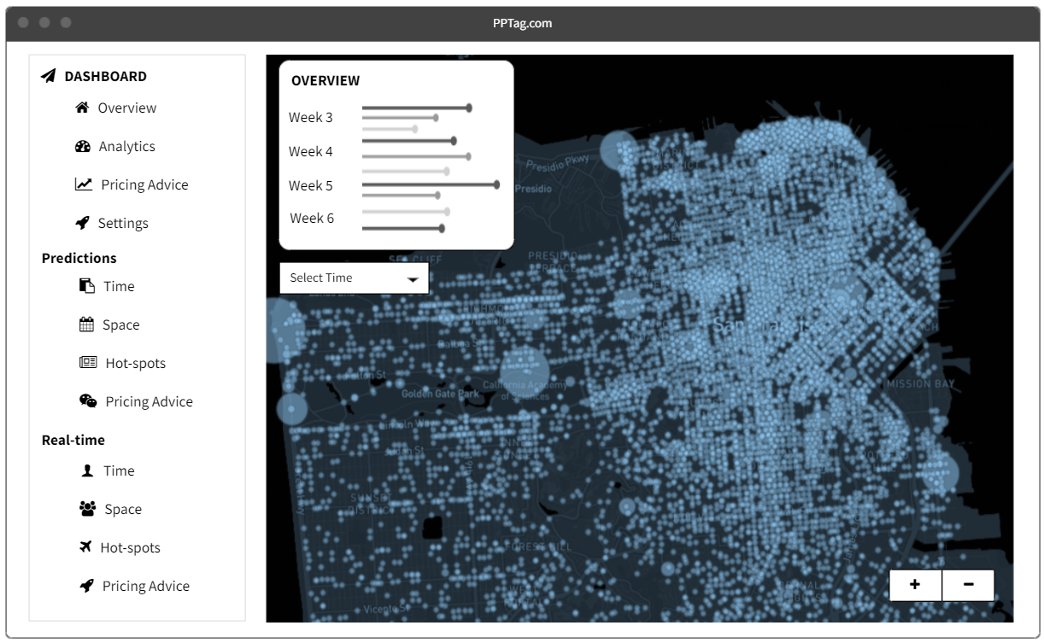
Application
Interface
Wireframes of PP-Tag

Slide 12
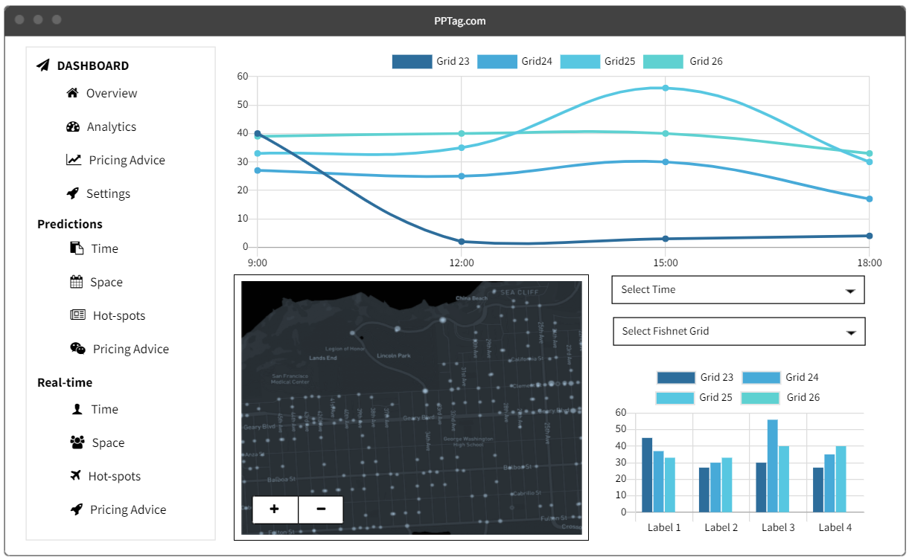
Application
Interface
Wireframes of PP-Tag

